Slide 1
Management of Chronic Health Disorders

Slide 2
Agenda
Quality of Life
Responses to Chronic Health Disorders
Comanagement of Chronic Health Disorders
Interventions

Slide 3
Important Terminology
Chronic health disorder – a disease that a person experiences over an extended period of time
Ex: partial hearing loss, hypertension, Alzheimer’s disease, cancer
Quality-of-life – a multidimensional rating of a person’s wellbeing, that accounts for physical, mental, cognitive, social, and spiritual health
Comorbidity – the addition of a disease (or diseases) during the assessment or treatment of a pre-existing condition
Ex: cancer and depression
Typically considered disease-focused
Multimorbidity – the co-existence of multiple diseases, where one disease is not more prominent than the other(s)
Ex: anxiety and depression
Typically considered patient-focused

Slide 4
What are the similarities & differences between a chronic illness and a terminal illness?

Slide 5
Quality-of-Life
Assessments measure the extent to which a patient’s normal life activities have been compromised by disease and treatment.
Components: ability to maintain normal life functioning, as well as physical, mental, cognitive, social, and spiritual health (though inclusion in assessments may vary)
As survivability of chronic illnesses have increased, Q-o-L has become a larger concern
Can be a determining factor in treatment selection
Q-o-L can impact success of treatments and severity symptoms

Slide 6
Responses to Diagnosis
Being diagnosed with a chronic illness can massively impact a patient’s life, and can lead to denial, anxiety, and depression
Consider: What are common symptoms of anxiety and depression? What are common symptoms of being immunocompromised?
These can impact treatment adherence and symptom severity
Diagnosis can impact a person’s self-concept (the set of beliefs about one’s personal qualities). Domains impacted include:
Body image
Physical health & capability
Sense of achievement/ cognitive ability
Social-ness
Personal beliefs

Slide 7
Coping with Chronic Health Disorders
People use a variety of strategies, including:
Social support or direct problem solving.
Distancing.
Positive focus.
Cognitive escape or avoidance.
Behavioral escape or avoidance.
Strategies that work: Active (approach-oriented) coping, maintaining a positive focus that emphasizes self-efficacy
Potential concern: during the coping process, a patient may develop unhealthy or inaccurate beliefs about their disorder and what caused its development

Slide 8
Chronic Health Disorder Comanagement
Comanagement – the process of managing a disorder from multiple domains simultaneously
In addition to the more straightforward physical and mental outcomes, a chronic health disorder can impact accessibility, workplace performance, family dynamics, sexual health, dietary restrictions, and spiritual/ emotional needs
A treatment team can include: illness-specific physicians, physical therapists, occupational therapists, dietitians, social workers, and more
Often, a heavy reliance is placed on caregivers

Slide 9
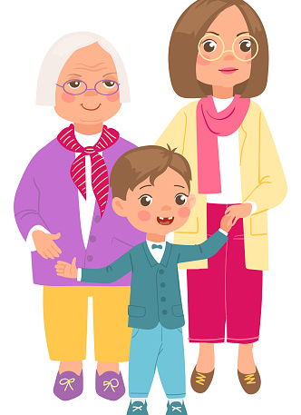
How might having a chronic illness be different for… an 8-year-old? a 30-year old? an 80-year old? How might caregiving look different for these ages?

Slide 10
Interventions
Pharmacological interventions
May including additions like antidepressants
Individual therapy
More episodic/ as-needed than traditional therapy sessions
Requires a therapist knowledgeable about that chronic health disorder
Typically focuses on building coping skills and reducing anxiety
Mindfulness-based therapies (relaxation training, expressive writing, Acceptance and Commitment Therapy, etc.)
Physical rehabilitation and exercise
Social support (including friends/family and support groups)

Slide 11

Treatment Priorities
Treatment Adherence
-better at preventing illness progression
-reduce hospitalizations
-increase survival rates
-provides sense of structure
-risk of fatigue and burnout
Quality-of-Life
-provides sense of autonomy
-can reduce anxiety/ depression
-helps sustain long-term adherence to key aspects
-can facilitate compassion
-decreases long-term health/ survivability

Slide 12
Next Time on PSY 440…
Before Next Class:
Complete today’s journal prompt
Due TOMORROW at 11:59 pm
In Our Next Class:
Class activity!
Group selection depends on journal prompts, so please do not be late submitting your response

